Slide 1
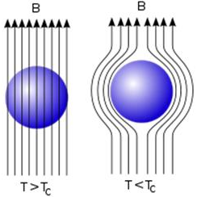
Super conductors and their applications
Diamagnetism and the Meissner effect:
Diamagnetism→ When a current is induced in a material to oppose an applied magnetic field. These induced currents produce magnetisation in the material, again opposing the applied field.
Superconductors have perfect diamagnetism, this is the Meissner effect. All internal fields are expelled from the material by the induced currents.
Magnetic field lines, represented as arrows
Super conductor basics
Deffinition
Propperties e.g. R=0, mag field expelled
Graphs
Critical temp
Uses:
London equations
Eleanor Grogan, Kristopher Green and Amber Summerly

